Slide 1

Grievance Management Systems
Guided By :Ram Shankar
137Y1AO556 Ch.sonia
137Y1A0599 V.Harshita
137Y1A05A0 V.Krishna Sandila

Slide 2
ABSTRACT
Grievance Management System (GMS) is a set of procedures used in organizations to address complaints and resolve disputes. Grievance Management systems in the US have undergone several innovations especially since about 1970 with the advent of extensive workplace regulation.
Grievance has strict time lines which must be met in the processing of this formal complaint, until it is resolved.

Slide 3
PURPOSE
Using the latest and cutting edge technology software for maintaining this application the disputes can be resolved by higher authority without any negotiations.
With this fully automated Grievance management system, we can provide more ease and security for users and the one operating it.

Slide 4
EXISTING SYSTEM
Existing system is the manual system. In this system huge expenditure and a lot of time is spent in communicating the information across different branches.
It takes more effort and physical space to keep track of paper documents, to find information and to keep details secure.

Slide 5
DISADVANTAGES
Convention system makes use of huge amount of recording issues, secrecy in unionized places.
Complainer queries can be difficult to respond to as information is stored in different places and may even require that you find the right person before being able to respond .
Lack of security.
Time consuming and costly to produce reports .

Slide 6
PROPOSED SYSTEM
computerization of the Complaints.
Provides more security for the data by providing authentication. We can keep our entire data in a centralized database.
Our application will give more flexibility to the users and the one operating it.

Slide 7
ADVANTAGES
Leads to gain a better management control over the complaints.
Facilitating speedy processing of Grievances received.
Updating the status of Grievances as and when required.
Informing the complainer about the action taken by the Authority and Management.
Computerization of complaints received and solved.

Slide 8
SOFTWARE REQUIREMENTS
Operating System : Windows XP
User Interface : HTML, CSS
Client-side Scripting : JavaScript
Programming Language : Java
Web Applications : JDBC, JNDI,JSP
Database : My SQL 5.0
Server Deployment : Apache Tomcat5.0/6.0

Slide 9
HARDWARE REQUIREMENTS
Processor : Pentium IV
Hard Disk : 120 GB
RAM : 512 MB

Slide 10
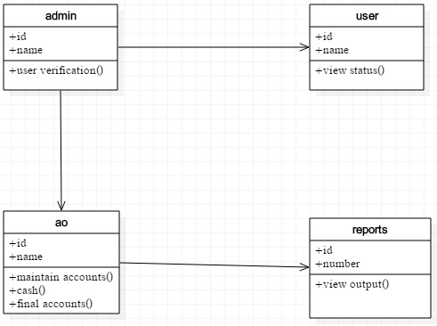
UML DIAGRAMS
CLASS DIAGRAM :

Slide 11
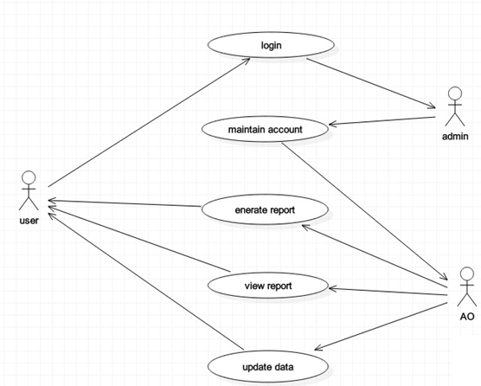
USECASE DIAGRAM :

Slide 12
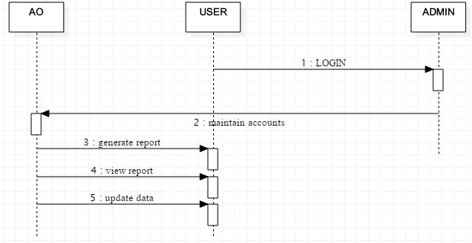
SEQUENCE DIAGRAM :

Slide 13
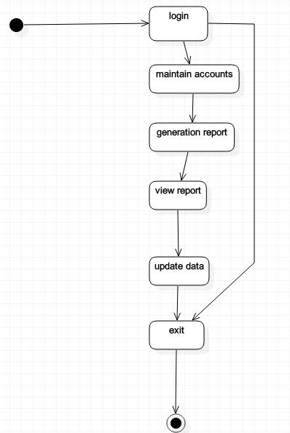
STATE CHART DIAGRAM :

Slide 14
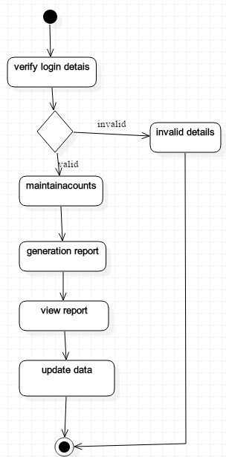
ACTIVITY DIAGRAM :

Slide 15
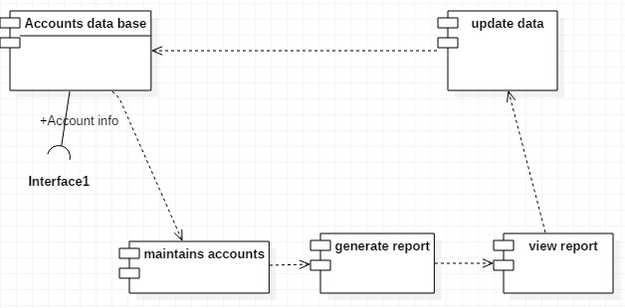
COMPONENT DIAGRAM :

Slide 16
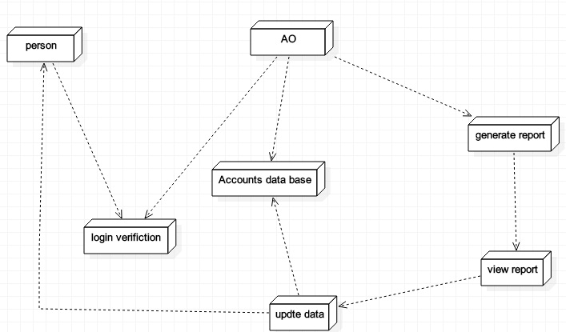
DEPLOYMENT DIAGRAM :

Slide 17
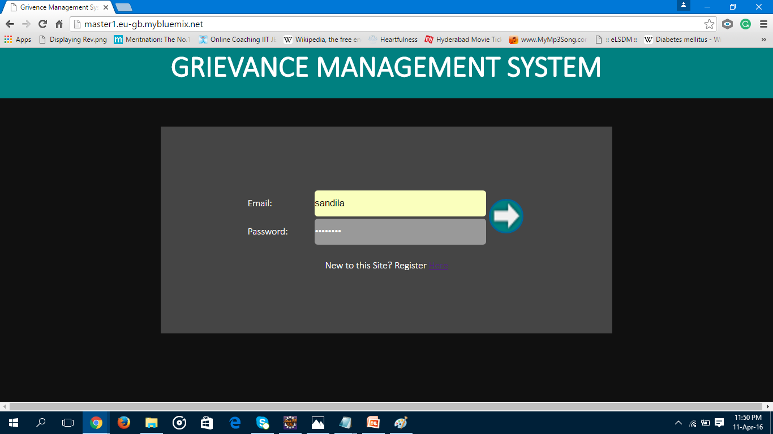
SCREEN SHOTS
MAIN PAGE:
In this page the register link and log In link reside. With particular link accessed the action accomplished will be performed.

Slide 18
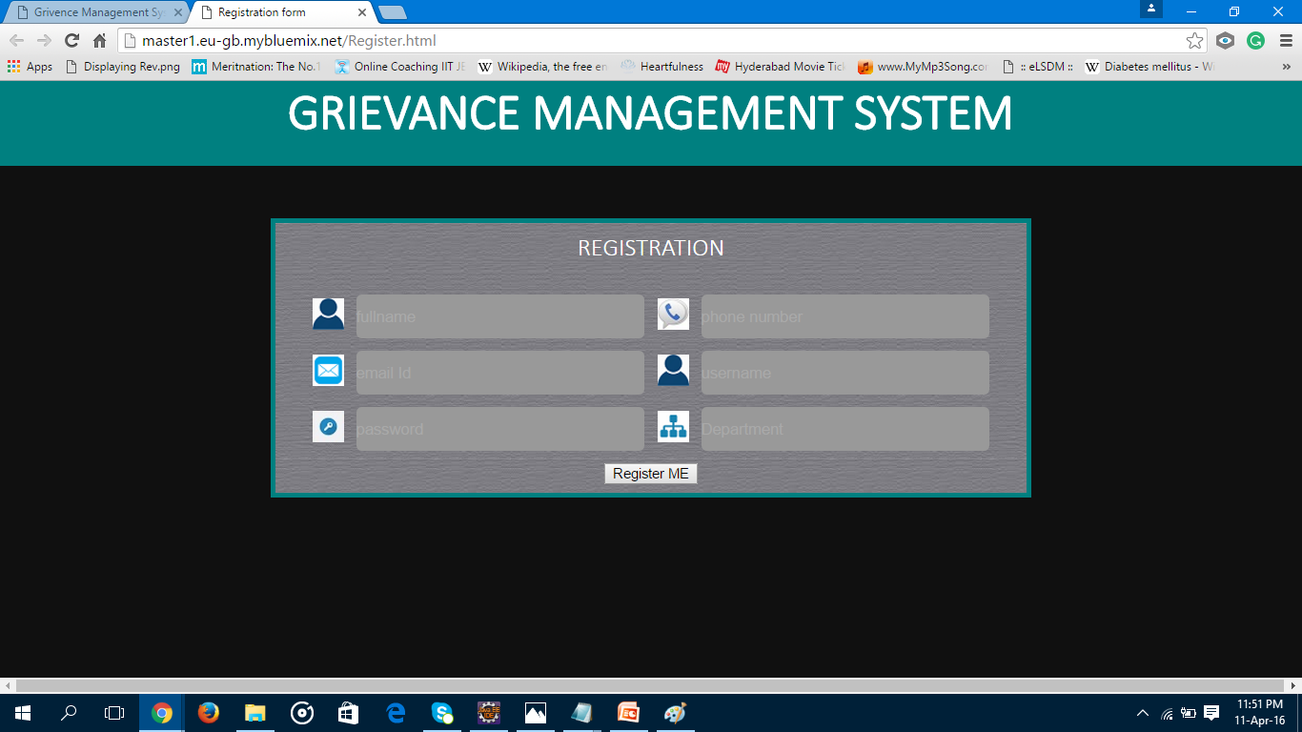
REGISTRATION PAGE:
In this registration page, complainers and the authority will register their accounts and then will be a part of this website.

Slide 19
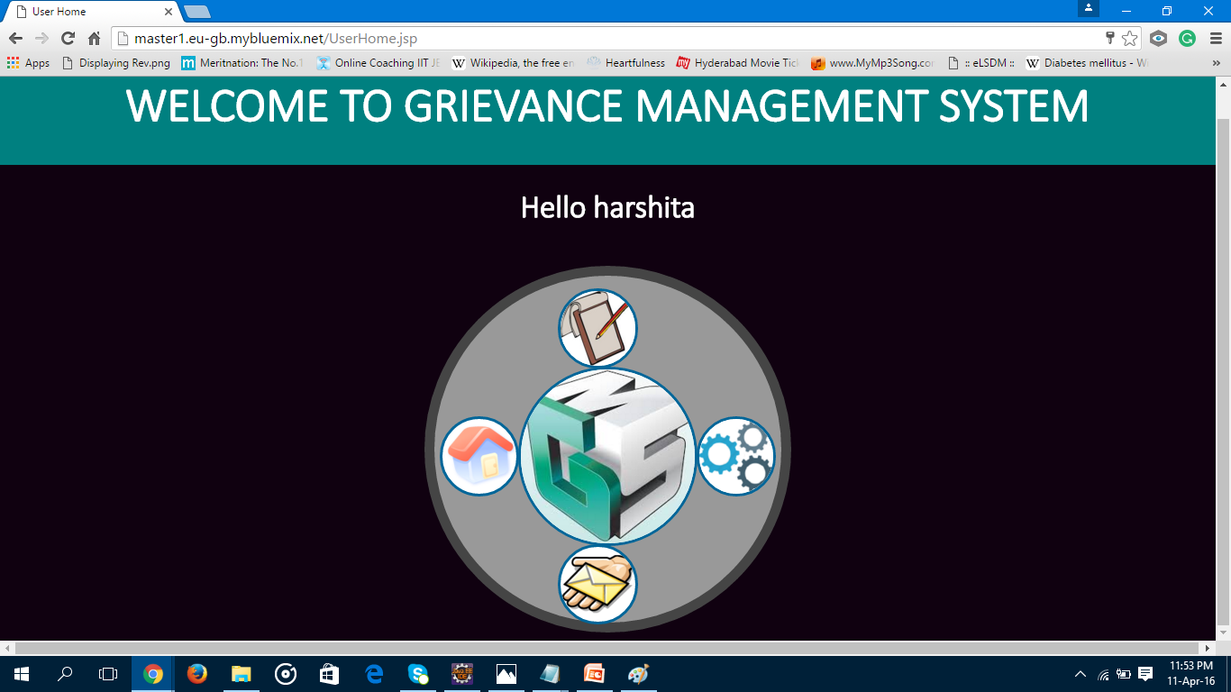
DASHBOARD:
Now as soon as they login into their accounts, they can see their dashboard having different options like posting a complaint, updating their profile, seeing status of posts being posted, which you can see in this screen shot.

Slide 20
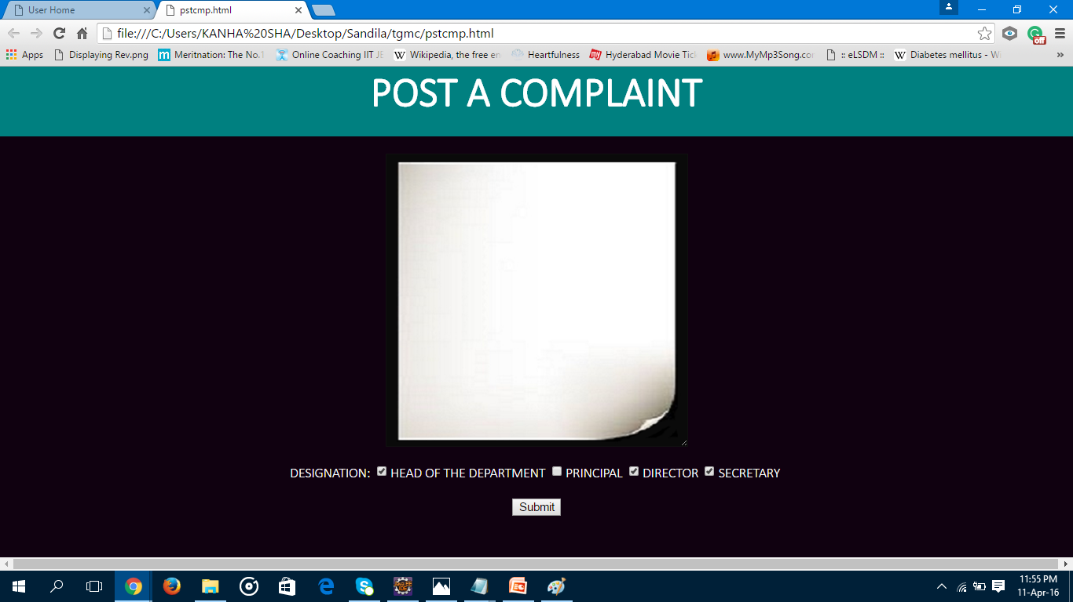
POST COMPLAINT :
In this post complaint, every one who has some problem to share and resolve with will have to register and log in and post a complaint and based on severity, post will be posted for different authorities.

Slide 21
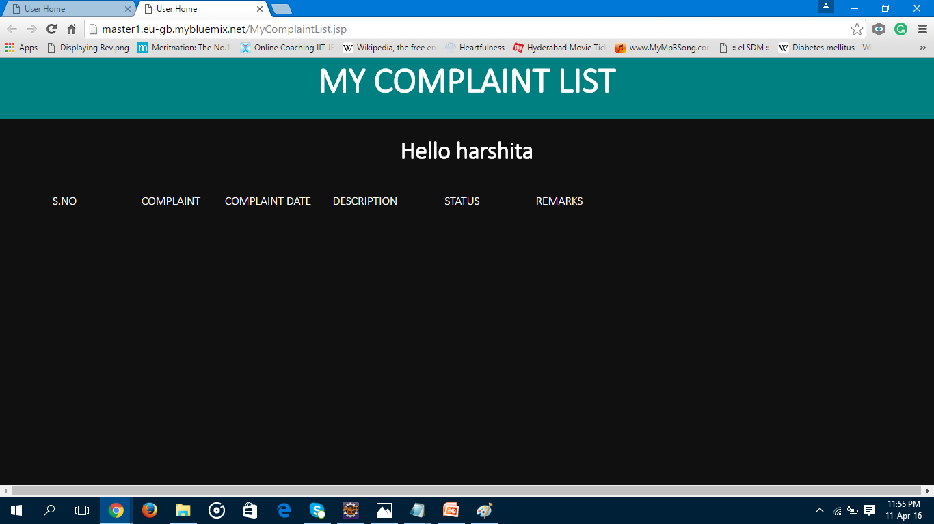
COMPLAINT STATUS:
In this, the complaints which are being posted and their level of severity can be show and their status means whether post has been resolved or still in process.

Slide 22
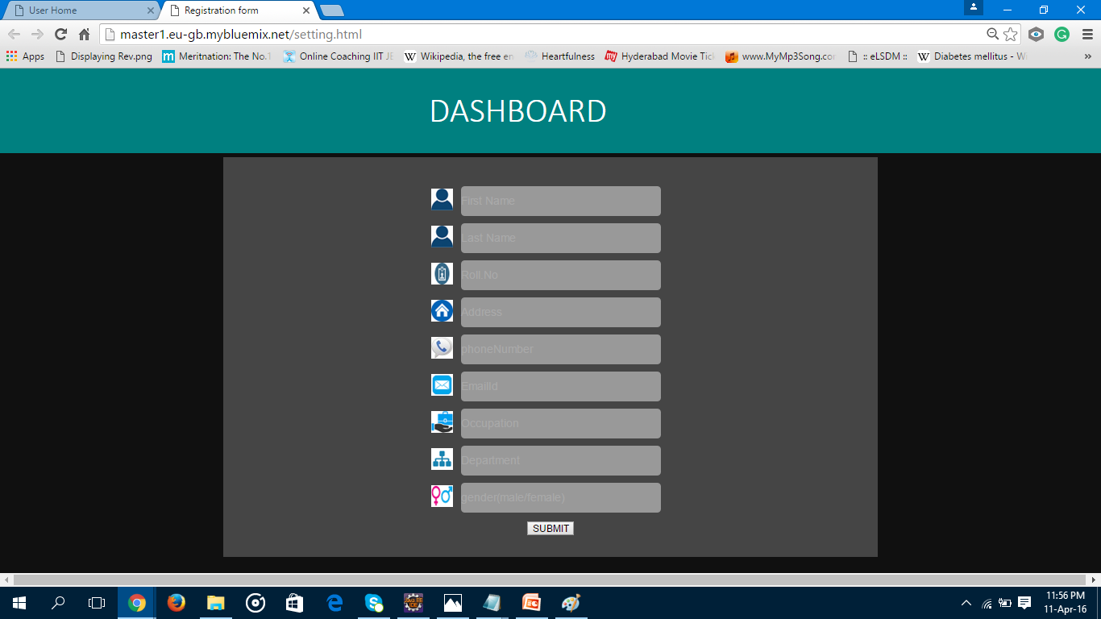
SETTINGS PAGE:
As the name itself says that it is for settings, we can update our profile preferences here.

Slide 23
CONCLUSION
Here by we conclude that “In this application we can provide more security and convenience for the students by making them comfortable with the surroundings”.
By using this application the students can easily solve the daily problems those may be inwards or outwards.

Slide 24


